Slide 1
Jewellery Listing App
TEAM MEMBERS :
SAGAR AHUJA
JOSHUA JOSEPH
PIYUSH THAKUR
GYAN PUNJ
AMAN KUMAR RASTOGI
TORRY HARRIS BUSINESS SOLUTION

Slide 2
PROBLEM STATEMENT :
You need to build a “Jewellery Listing App" which should have bare minimum CRUD capabilities.
Create Listing
Edit added Listing
List different Listing
Delete Listing

Slide 3
About the Project :
The purpose of this Jewellery Listing App is that an admin user can create a new jewellery listing within the website, and after creating the listing is able to perform certain actions like see that listing if the listing is readable, or edit that listing by entering some other values in the given fields and is able to delete that listing if needed.
We were able to create this jewellery listing app with the help of certain tech stack ranging from html to amazon aws.

Slide 4
Tech Stack :
- Java Spring Boot
- Html, CSS, JS
- Maven
- MySQL
- Docker
- AWS EC2

Slide 5
Maven :
Maven is a popular open-source build tool developed by the Apache Group to build, publish, and deploy several projects at once for better project management.
Maven automates the entire process which includes compiling source code and makes java developers daily work easy.

Slide 6
Docker :
Docker is an open platform for developing, shipping, and running applications. Docker enables you to separate your applications from your infrastructure so you can deliver software quickly.
Docker containers can run on a developer’s local laptop, on physical or virtual machines in a data center, or on cloud.

Slide 7
AWS EC2:
Amazon Elastic Compute Cloud (EC2) is a part of Amazon Web Services (AWS), that allows users to rent virtual computers on which to run their own computer applications. EC2 encourages scalable deployment of applications by providing a web service through which a user can boot an Image to configure a virtual machine.

Slide 8
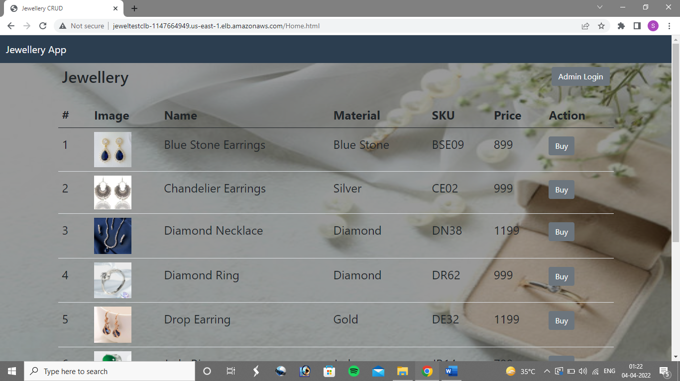
Landing Page

Slide 9
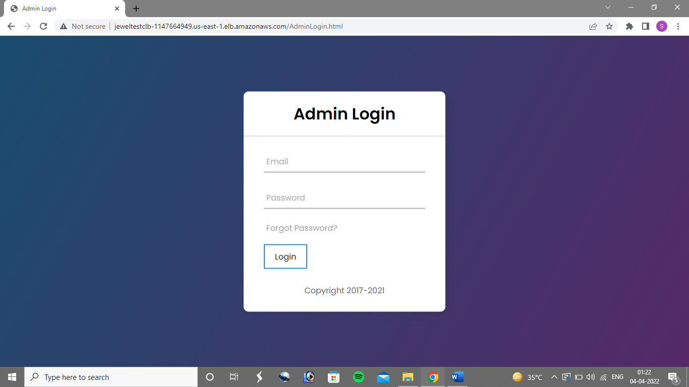
Admin Login

Slide 10
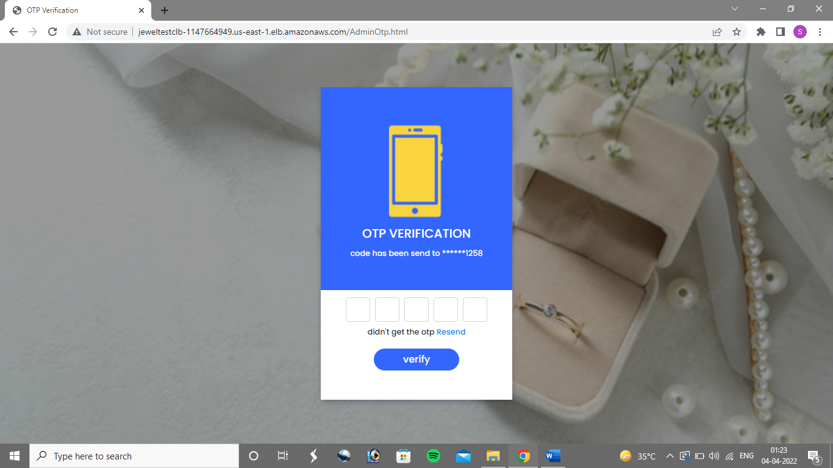
Admin Otp Verification

Slide 11
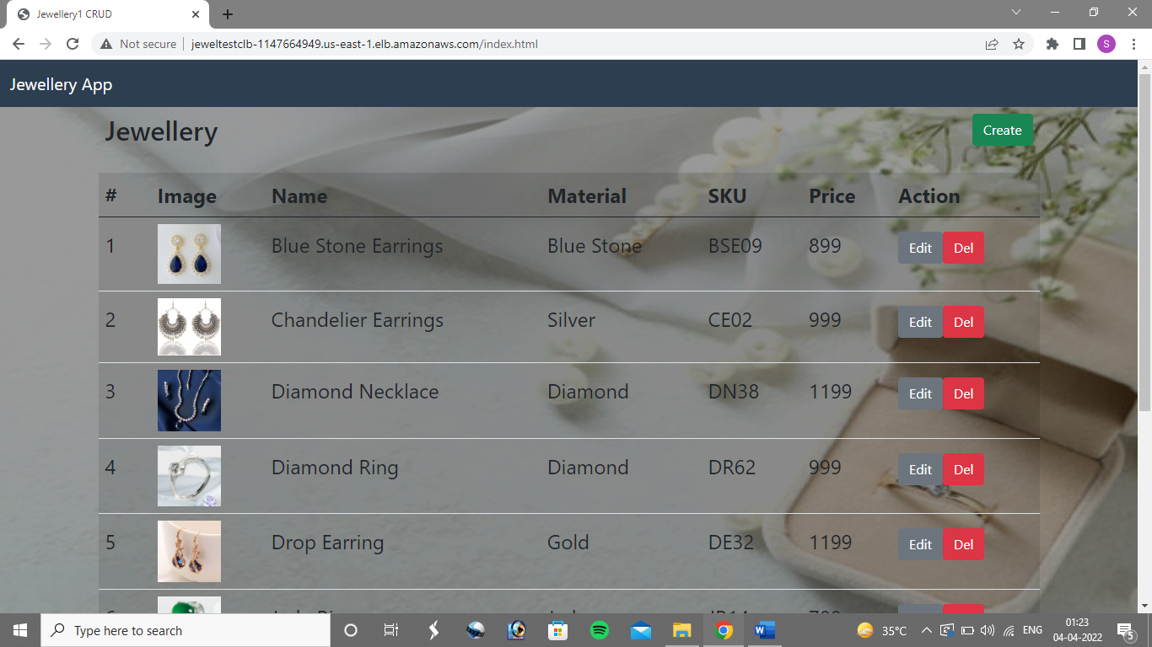
Admin Page for CRUD Operations

Slide 12
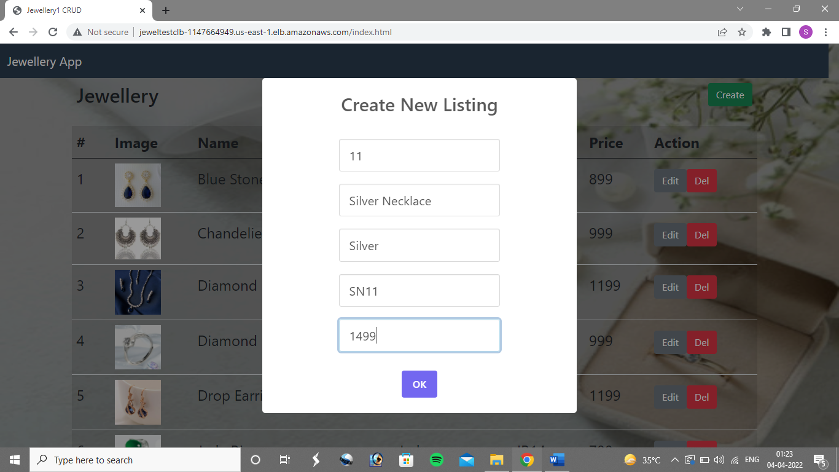
Create Operation

Slide 13
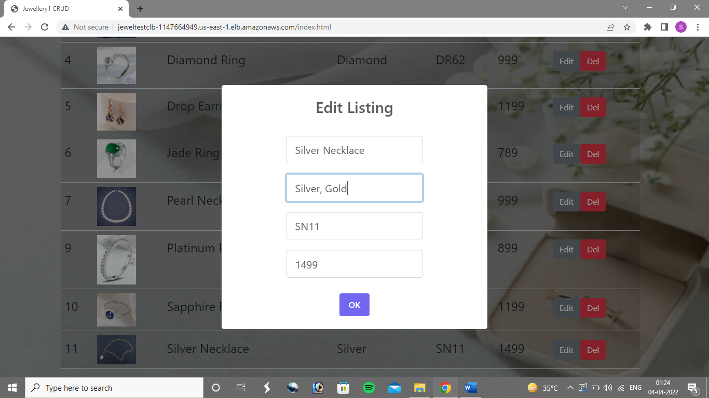
Update Operation

Slide 14
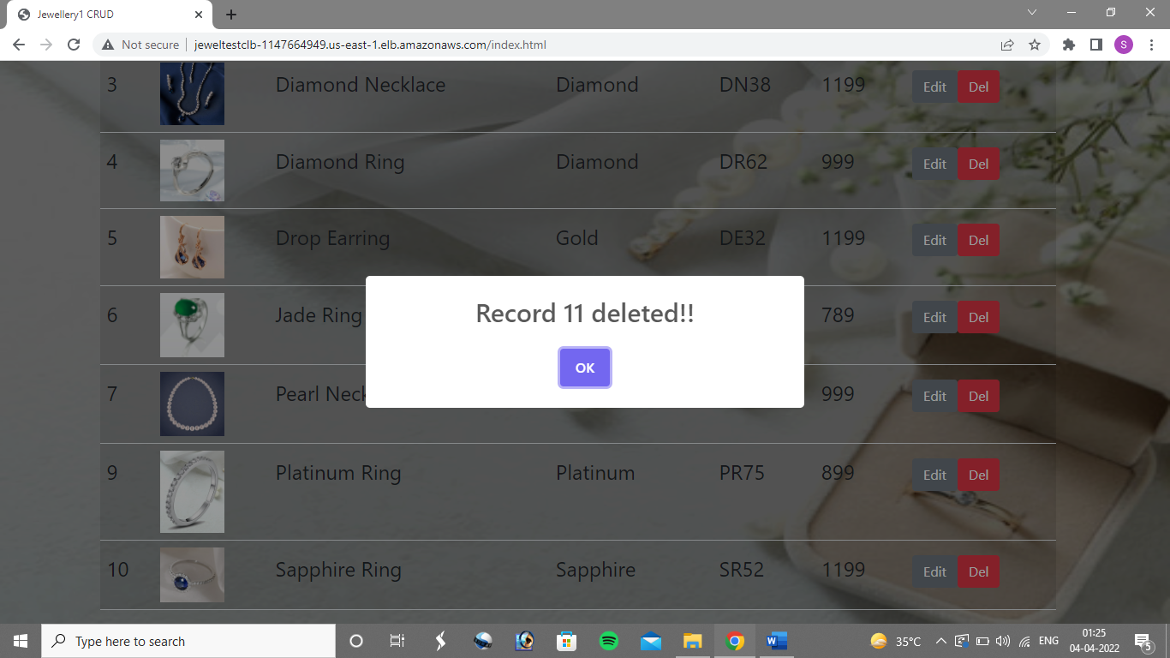
Delete Operation

Slide 15
THANKYOU
TORRY HARRIS BUSINESS SOLUTION

